Slide 1
Obstacles that thwart a successful analysis of micro-array data
Development of specific, more appropriate statistical tools for use with microarrays
Intimacy with nature (strengths and deficiencies) of the raw data
Intimacy with nature (strengths and deficiencies) of the raw data
Facile use of computer operating system is absent
Facile use of computer operating system is absent
Biological interpretation
Biological interpretation
Thorough mining of the data for useful information
Biology experiment complete
Inadequate
Computer skills to handle large datasets
Functional annotation of results
Inadequate
Computer skills to handle large datasets
Application of available statistical tools
Functional annotation of results
Application of available statistical tools

Slide 2
Benefits of the Gene Array Approach
1. Interrogates thousands of genes. (12,000 55,000 28,869)
2. Versatile with respect to tissues.
3. Recently expanded beyond major biomedical research models.
4. Asks which genes are affected by a treatment?
5. Equivalent to 35,000 northern blots overnight.
6. Time course experiments gain immense value.

Slide 3
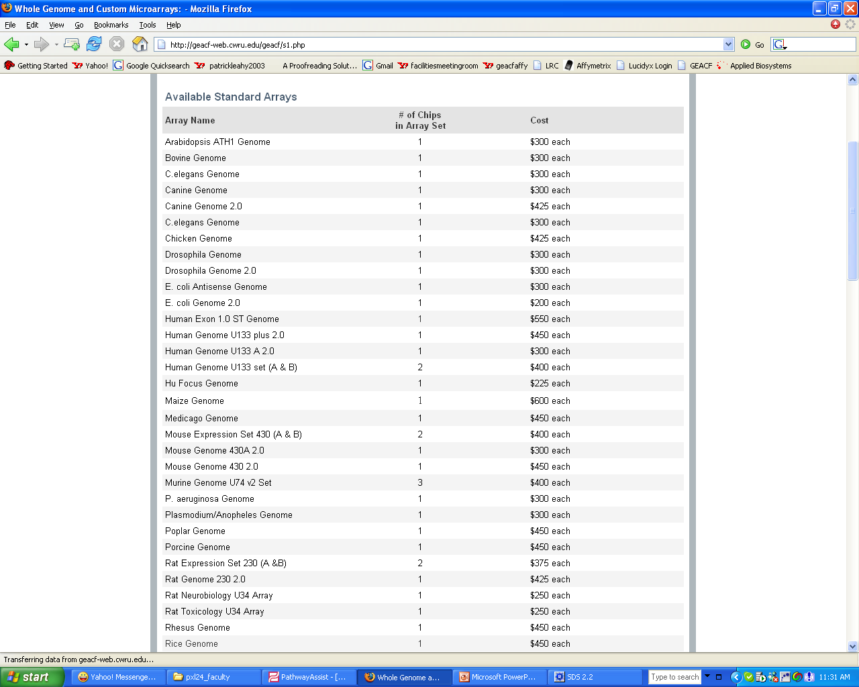
Genechip

Slide 4
What is covered in this course?
Data mining
TotRNA
Pattern mining
Hyb. cRNA cocktail
Hybridize to Affy arrays
Generate Affy.dat file
Output as Affy.chp file
Export as Text file
Pathway Analysis
Case/UH Core Facility
Illumina platform at CCF facility

Slide 5
WT Expression Array Design
5’
3’
Validate using Blast and Tm
Only PM used
Perfect Match
25 mer DNA oligo
Probe Set (<= 26 probes)
Perfect Match
Mismatch
11μ
11μ
PM
Probe Cell

Slide 6
cRNA preparation
Total RNA (1-5 μg)
AAAAAAAAA
cDNA Strand 1 synthesis
AAAAAAAAA
TTTTTTTTTNNNNNNNNN
T7RNA pol. promoter
SS II reverse transcriptase
E. coli DNA pol. I
cDNA Strand 2 synthesis
AAAAAAAAA
NNNNN
TTTTTTTTTNNNNNNNNN
T7RNA pol. promoter
………..
………..
UUUUUUUUUU
………..
………..
UUUUUUUUUU
1. Conversion to cRNA 2. Amplification (linear) 3. Labelling (biotin)
………..
IVT cRNA synthesis amplifies and labels transcripts with Biotin
UUUUUUUUUU
UUUUUUUUUU
UUUUUUUUUU
AAAAAAAAAAAAAAN
NNNNNNNNNNNNN
NNNNNNNN
T
T
T₇ RNA pol.
T
T
T
TTTTTT
T
T
Fragmented cRNA
cRNA is now ready for hybridization to test chip

Slide 7
Sample is added to a hybridization cocktail along with spiked control transcripts and is loaded onto an array chip
Chip is placed in a hybridization oven and incubated overnight
Hybridization cocktail
Affymetrix Array Chip
Chips are placed in the Fluidics station where they are washed, stained and washed again (2.5 hours)
After staining, the signal intensities are measured with a laser scanner (15 min)
Data is acquired by the computer as soon as the scan has been completed.

Slide 9
The first image is “sample1.dat.” note the pixel to pixel variation within a probe cell
A “*.cel.” file is automatically generated when the “*.dat” image first appears on the screen. Note that this derivative file has homogenous signal intensity within its probe cells

Slide 10
How do we get the individual gene signals using RMA in EC?
Sample 1
Sample 2
Sample 3
Gene 1
g1p3
g1p1
g2p1
Average
g1p4
g1p1
g1p1
g1p2
g2p4
g1p2
g2p3
g1p2
g2p3
g1p3
g1p2
g1p3
g3p4
g1p3
g1p1
g1p4
g3p1
g1p4
g2p2
g1p4
g3p2
g3p2
g1p1
g2p2
Gene 2
g1p1
g3p1
g1p3
g2p1
g2p1
g2p1
g2p2
g2p2
g3p3
g3p1
g2p2
g2p2
g2p3
g2p3
g2p4
g2p3
g3p3
g2p3
g1p3
g3p3
g2p4
g2p4
g3p4
g2p4
g1p2
g1p4
g1p2
g2p1
g1p4
g2p1
Gene 3
g3p1
g3p1
g3p1
g3p4
g3p2
g2p4
g3p2
g3p2
g3p2
g3p3
g3p3
g3p3
g3p4
g3p4
g3p4
G
G

Slide 11
Sample 1
Sample 2
Sample 3
Gene 1
g1p1
g1p3
g1p1
g2p1
g1p1
g1p4
g1p2
g2p4
g1p2
g2p3
g1p2
g2p3
g1p3
g1p2
g1p3
g3p4
g1p3
g1p1
g1p4
g3p1
g1p4
g2p2
g1p4
g3p2
g3p2
g1p1
g2p2
Gene 2
g1p1
g3p1
g1p3
g2p1
g2p1
g2p1
g2p2
g2p2
g3p3
g3p1
g2p2
g2p2
g2p3
g2p3
g2p4
g2p3
g3p3
g2p3
g1p3
g3p3
g2p4
g2p4
g3p4
g2p4
g1p2
g1p4
g1p2
g2p1
g1p4
g2p1
Gene 3
g3p1
g3p1
g3p1
g3p4
g3p2
g2p4
g3p2
g3p2
g3p2
g3p3
g3p3
g3p3
g3p4
g3p4
g3p4
G
G

Slide 12
Sample 1
Sample 2
Sample 3
Gene 1
g1p1
g1p3
g1p1
g2p1
g1p1
g1p4
g1p2
g2p4
g1p2
g2p3
g1p2
g2p3
216
g1p3
50
g1p3
150
g1p3
g1p2
g3p4
g1p1
g1p4
g3p1
g1p4
g2p2
g1p4
g3p2
g3p2
g1p1
g2p2
Gene 2
g1p1
g3p1
g1p3
g2p1
g2p1
g2p1
g2p2
g2p2
g3p3
g3p1
g2p2
g2p2
120
150
300
g2p4
g2p3
g2p3
g2p3
g3p3
g2p3
g3p3
g1p3
g2p4
g2p4
g2p4
g3p4
g1p4
g1p2
g1p2
g2p1
g1p4
g2p1
Gene 3
g3p1
g3p1
g3p1
g3p4
g3p2
g2p4
g3p2
95
g3p2
g3p2
g3p3
112
110
g3p3
g3p3
g3p4
g3p4
g3p4
G
G

Slide 13
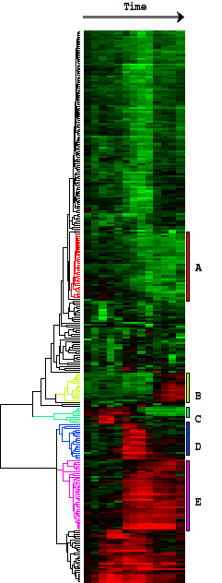
Pairs used
Abs. Call
Fold Change
Probe set
Pos
Neg
Ave Diff
Diff Call
Pairs
YDL200C
16
2
2378
10.5
20
18
P
NC
YDL200D
16
3
237
M
4.9
20
19
I
YDM167A
7
7
5003
A
15
20
14
MI
MD
-11.8
D
-3.7
Data manipulation is essential prior to submission of results to third party clustering and analytical programs
SOMs
Hierarchical clustering
Plaid clustering
Notes:
Prior to presenting data to third party clustering software, some data manipulation is essential. The facility offers a service in this area.
For example, data from Affymetrix software usually comes in two forms. The numerical values ( Average difference, average difference change and fold change) are accompanied by a higher authority “difference call.” If the fold change column reads 10.5 for a particular gene but the accompanying difference call column says “NC” or “no change, then there is no significant difference between the experimental and baseline samples for that gene.” If you were to present the data as is to a clustering program, that program will simply use the numeric value and co-cluster that gene along with other bone fide fold changes of similar magnitude. Clearly this would lead to spurious results. One needs to manipulate the data to reflect this situation in order to ensure that misleading data is not included in the analyses.

Slide 14
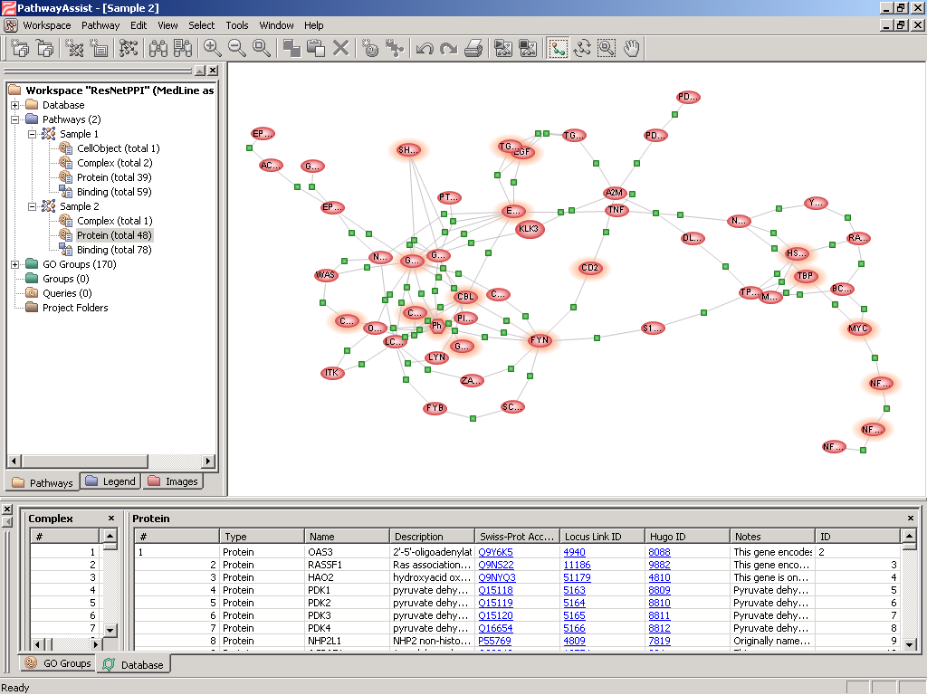

Slide 15
SOMs
Self organizing maps or SOMs are a popular method for detecting patterns in large data sets
Notes:
Self Organizing Maps are another popular method used at the Facility for looking at large data sets. One can ask the clustering program to display groups of genes that behave in a similar manner during different treatments or at different time points in an experiment. As in this example, where samples from four treatments are compared, the program clusters or groups genes which share similar expression patterns across all four treatments. Consider two clusters that have been highlighted. In the panel highlighted in red, we see a group of 53 gene for which expression was similarly increased in the second of the four different treatments. Similarly, in panel c15 (outlined in green) 122 genes responded similarly to the treatments and the group is characterized by an increase in expression in the last of the four treatments.

Slide 16
How do we get the individual gene signals using RMA in EC?
Sample 1
Sample 2
Sample 3
Gene 1
g1p3
g1p1
g2p1
Average
g1p4
g1p1
g1p1
g1p2
g2p4
g1p2
g2p3
g1p2
g2p3
g1p3
g1p2
g1p3
g3p4
g1p3
g1p1
g1p4
g3p1
g1p4
g2p2
g1p4
g3p2
g3p2
g1p1
g2p2
Gene 2
g1p1
g3p1
g1p3
g2p1
g2p1
g2p1
g2p2
g2p2
g3p3
g3p1
g2p2
g2p2
g2p3
g2p3
g2p4
g2p3
g3p3
g2p3
g1p3
g3p3
g2p4
g2p4
g3p4
g2p4
g1p2
g1p4
g1p2
g2p1
g1p4
g2p1
Gene 3
g3p1
g3p1
g3p1
g3p4
g3p2
g2p4
g3p2
g3p2
g3p2
g3p3
g3p3
g3p3
g3p4
g3p4
g3p4
G
G

Slide 17
Sample 1
Sample 2
Sample 3
Gene 1
g1p1
g1p3
g1p1
g2p1
g1p1
g1p4
g1p2
g2p4
g1p2
g2p3
g1p2
g2p3
g1p3
g1p2
g1p3
g3p4
g1p3
g1p1
g1p4
g3p1
g1p4
g2p2
g1p4
g3p2
g3p2
g1p1
g2p2
Gene 2
g1p1
g3p1
g1p3
g2p1
g2p1
g2p1
g2p2
g2p2
g3p3
g3p1
g2p2
g2p2
g2p3
g2p3
g2p4
g2p3
g3p3
g2p3
g1p3
g3p3
g2p4
g2p4
g3p4
g2p4
g1p2
g1p4
g1p2
g2p1
g1p4
g2p1
Gene 3
g3p1
g3p1
g3p1
g3p4
g3p2
g2p4
g3p2
g3p2
g3p2
g3p3
g3p3
g3p3
g3p4
g3p4
g3p4
G
G

Slide 18
Sample 1
Sample 2
Sample 3
Gene 1
g1p1
g1p3
g1p1
g2p1
g1p1
g1p4
g1p2
g2p4
g1p2
g2p3
g1p2
g2p3
216
g1p3
50
150
g1p3
g1p2
g3p4
g1p3
g1p1
g1p4
g3p1
g1p4
g2p2
g1p4
g3p2
g3p2
g1p1
g2p2
Gene 2
g1p1
g3p1
g1p3
g2p1
g2p1
g2p1
g2p2
g2p2
g3p3
g3p1
g2p2
g2p2
120
150
300
g2p4
g2p3
g2p3
g2p3
g3p3
g2p3
g3p3
g1p3
g2p4
g2p4
g2p4
g3p4
g1p4
g1p2
g1p2
g2p1
g1p4
g2p1
Gene 3
g3p1
g3p1
g3p1
g3p4
g3p2
g2p4
g3p2
95
g3p2
g3p2
g3p3
112
110
g3p3
g3p3
g3p4
g3p4
g3p4
G
G

Slide 19
The information content of the human genome
7% not transcribed
}
1% ORF
Protein-coding genes
1%UTR
Functional Long
ncRNAs
35-40% Intron
Non-protein-coding RNAs
~10%
The Human Genome
Small RNAs
ENCODE Consortium (Nature 2007 Vol 447: 799-816)

Slide 20
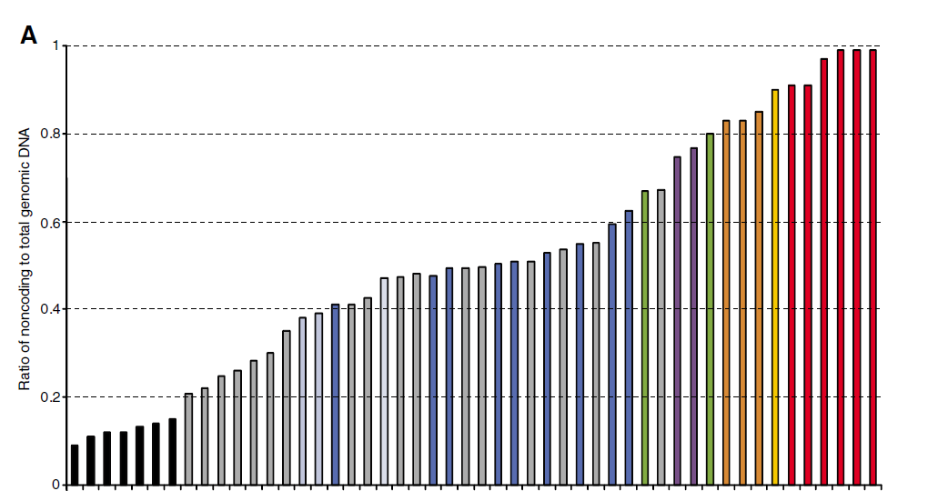
The increase in complexity among eukaryotes is concomitant with an increase in the ratio of non-coding to coding DNA
Mattick, 2007

Slide 21
Obstacles that thwart a successful analysis of micro-array data
Development of specific, more appropriate statistical tools for use with microarrays
Intimacy with nature (strengths and deficiencies) of the raw data
Intimacy with nature (strengths and deficiencies) of the raw data
Facile use of computer operating system is absent
Facile use of computer operating system is absent
Biological interpretation
Biological interpretation
Thorough mining of the data for useful information
Biology experiment complete
Inadequate
Computer skills to handle large datasets
Functional annotation of results
Inadequate
Computer skills to handle large datasets
Application of available statistical tools
Functional annotation of results
Application of available statistical tools

