Slide 1
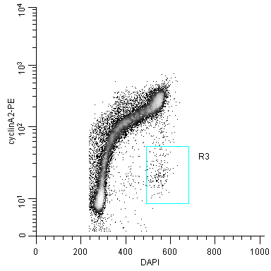
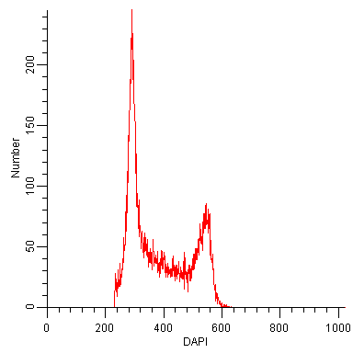
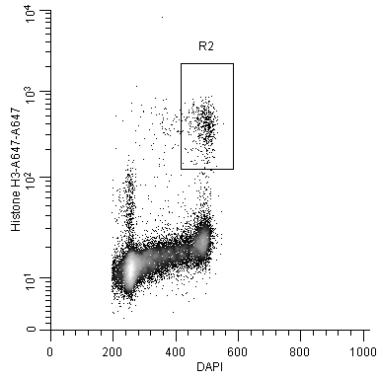
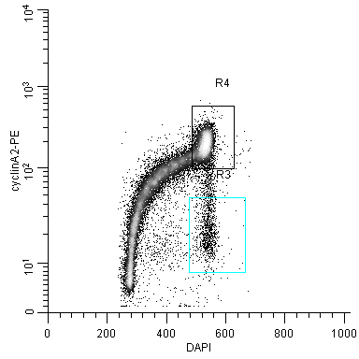
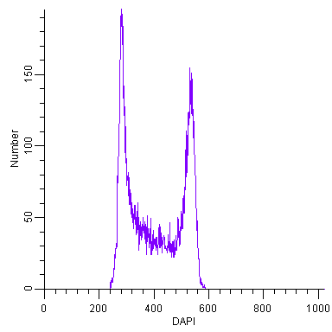
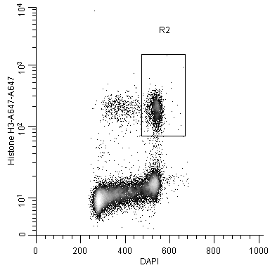
Untreated
G1
M
S
G2
Untreated

Slide 2
Untreated |  | SS Model, Untreated % | Nocodazole
Actual Values | Adj to 100% |  | Actual Values | Adj to 100% |  | Notes | Fold Change
50.75% | 49.64% | 48.11% | 0.3903 | 0.355 |  | G1 = lower | 0.715325419
25.54% | 24.98% | 25.74% | 0.2711 | 0.247 |  | S = same | 0.987301456
22.71% | 22.21% | 22.89% | 0.3436 | 0.313 |  | G2 = higher | 1.407269172
3.23% | 3.16% | 32.50% | 0.0941 | 0.086 |  | M = higher | 2.709743942
1.0223 |  | Using RC above | 1.0991

Slide 3
