Slide 1
Mathematical Models of dNTP Supply
Tom Radivoyevitch, PhD
Assistant Professor
Epidemiology and Biostatistics
CCCC Developmental Therapeutics Program

Slide 2

Single-Loop Temperature Control
5
10
0
controller
process
K_{p}
setpoint
+
water
temperature
∫
K_{i}
Σ
hot plate
-
process output = controller input; process input = controller output (= control effort)

Slide 3
Power Plant Process & Controls
+
Megawatts Demanded
PI
-
Megawatts Supplied
P
T
turbine
gas flow
turbine
T
condenser
recirc
air/o₂
stack
θ
-
PI
Setpoint
(3500 psi)
+
-
PI
Reheat Temp
fuel
+
Setpoint (1050F: variations break expensive thick pipes)
Boiler pressure ~ plasma [dN]
Fuel input ~ de novo dNTP supply
Cold Water bypass ~ cN-II/dNK cycle ~ police car in idle to catch speeders
Two temp control ~ drugs kill bad and good, rescue saves good and bad

Slide 4
Ultimate Goal
Better understanding => better control
Conceptual models help trial designs today
Computer models train pilots and autopilots
Safer flying airplanes with autopilots
Individualized, feedback-based therapies

Slide 5
dNTP Supply
flux activation
inhibition
ADP
nucleus
dATP
dCK
dA
DNA polymerase
GDP
dGTP
DNA
dCK
dG
CDP
dCTP
ATP
or
dATP
RNR
dCK
dC
mitochondria
UDP
dTTP
DCTD
cytosol
5NT
cytosol
TS
dA
dAMP
dATP
dUDP
dUMP
TK1
dGK
dT
dG
dGMP
dGTP
dUTP
dUTPase
dU
dN
dC
dCMP
dCTP
TK2
dT
dTMP
dTTP
NT2
dN
Many anticancer agents target or traverse this system.

Slide 6
MMR⁻ Treatment Hypothesis
IUdR
dNTP demand is either
Damage Driven
or
S-phase Driven
Salvage
dNTPs + Analogs
DNA + Drug-DNA
De novo
DNA repair

Slide 7
p53⁻ Treatment Hypothesis
Residual DSBs at 24 hours kill cells
dNTP supply inhibition retards DSB repair
p53⁻ cells are slower at DSB repair
Best dNTP supply inhibition timing post IR is just after p53⁺ cells complete DSB repair
Questions: Prolonged RNR↓ => plasma [dN]↓? Compensation by RNR overexpression? Is dCK expression also increased?
-
+
24 h

Slide 8
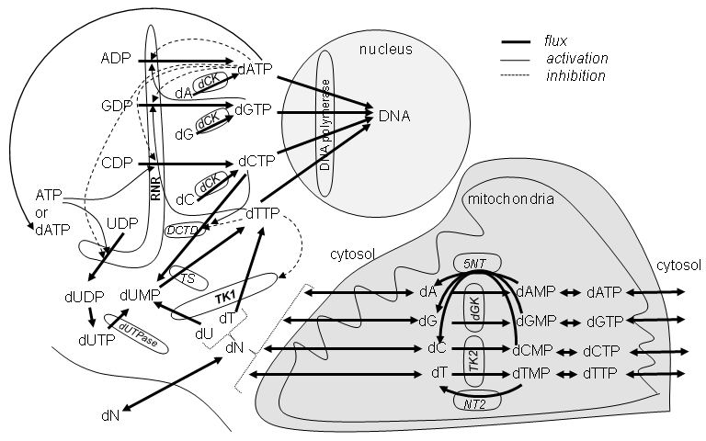
R Packages
Combinatorially Complex Equilibrium Model Selection (ccems, CRAN 2009)
Systems Biology Markup Language interface to R (SBMLR, BIOC 2004)
R1
R1
Model networks of enzymes
Model enzymes
R1
R1
R1
R1
R1
R1
R1
R1
R1
R1
R1
R2
R2
R2
R2
R1
R1
R1
R1
R2
R2

Slide 9
Enzyme Modeling Overview
Model enzymes as quasi-equilibria (e.g. E ES)
Combinatorially Complex Equilibria:
    few reactants => many possible complexes
R package: Combinatorially Complex Equilibrium Model Selection (ccems) implements methods for activity and mass data
  Hypotheses: complete K = ∞ ⬄ [Complex] = 0 vs binary K₁ = K₂
Generate a set of possible models, fit them, and select the best
Model Selection: Akaike Information Criterion (AIC)
  AIC decreases with P and then increases
  Billions of models, but only thousands near AIC upturn
Generate 1P, 2P, 3P model space chunks sequentially
Use structures to constrain complexity and simplicity of models

Slide 10
Ribonucleotide Reductase
ATP activates at hexamerization site??
dATP inhibits at activity site, ATP activates at activity site?
R1
R1
R1
R1
R1
R1
R1
R1
R1
ATP, dATP, dTTP, dGTP bind to selectivity site
UDP, CDP, GDP, ADP bind to catalytic site
R1
R1
R2
R2
R1
R1
R2
R2
R1
R1
R1
R1
R2
R2
5 catalytic site states x 5 s-site states x 3 a-site states x 2 h-site states = 150 states
(150)⁶ different hexamer complexes => 2^(150)⁶ models
2^(150)⁶ = ~1 followed by a trillion zeros
1 trillion complexes => 1 trillion (1 followed by only 12 zeros) 1-parameter models
RNR is Combinatorially Complex

Slide 11
Michaelis-Menten Model
E + S ES
but
so
Key perspective
RNR: no NDP and no R2 dimer => k_{cat} of complex is zero,
else different R1-R2-NDP complexes can have different k_{cat} values.

Slide 12
Free Concentrations Versus Totals
[S] vs. [S_{T}]
Substitute this in here to get a quadratic in [S] whose
solution is
Bigger systems of higher polynomials cannot be solved algebraically => use ODEs (above)
(3)
R=R1 r=R2₂
G=GDP t=dTTP
solid line = Eqs. (1-2)
dotted = Eq. (3)
Data from Scott, C. P., Kashlan, O. B., Lear, J. D., and Cooperman, B. S. (2001) Biochemistry 40(6), 1651-166

Slide 13
Enzyme, Substrate and Inhibitor
E ES
EI ESI
E ES
EI ESI
E ES
EI ESI
Competitive inhibition
E
EI ESI
E
EI ESI
E ES
EI
noncompetitive inhibition
Example of K=K’ Model
=
E | ES
EI | ESI
uncompetitive inhibition if k_{cat_ESI}=0
=
=
E ES
ESI
E ES
ESI
E
EI
E
ESI
E ES
=
E

Slide 14
dTTP induced R1 dimerization
Complete K Hypotheses
JJJJ
(RR, Rt, RRt, RRtt)
_{IJJJ}
JJIJ
JJJI
JIJJ
R
RR
R = R1
t = dTTP
R
R
RR
R
RR
R
RR
Rt
RRt
Rt
RRt
Rt
Rt
RRt
RRt
RRtt
RRtt
RRtt
RRtt
IJIJ
IJJI
JJII
IIJJ
JIIJ
R
JIJI
RR
R
R
R
RR
R
R
RR
Rt
Rt
RRt
Rt
RRt
RRt
RRtt
RRtt
RRtt
IJII
IIIJ
IIJI
JIII
IIII
I0II
III0
II0I
0III
R
R
R
R
RR
R
R
R
R
R
RR
Rt
RRt
Rt
RRt
RRtt
RRtt
Radivoyevitch, (2008) BMC Systems Biology 2:15

Slide 15
Binary K Hypotheses
R R
t t
K_{d_R_R}
RR
t t
R R
t t
K_{R_R}
RR
t t
|
|
|
|
?
|
|
=
K_{d_R_t}
=
K_{d_RR_t}
K_{R_t}
|
|
Rt R
t
K_{d_Rt_R}
RRt
t
=
Rt R
t
K_{Rt_R}
RRt
t
|
|
?
|
|
=
K_{d_R_t}
=
K_{d_RRt_t}
K_{R_t}
|
|
K_{d_Rt_Rt}
K_{Rt_Rt}
|
|
Rt Rt
|
RRtt
Rt Rt
|
RRtt
R R
t t
HDDD
RR
t t
HDFF
K_{R_R}
=
=
=
=
=
=
=
K_{R_t}
=
K_{RR_t}
=
=
Rt R
t
RRt
t
HIFF
K_{RRt_t}
=
=
=
=
=
=
=
=
=
RRtt

Slide 16
Fits to Data
Model | Parameter | Initial Value | Optimal Value | Confidence Interval
1 III0m | m1 | 90.000 | 82.368 | (79.838, 84.775)
 | SSE | 4397.550 | 525.178
 | AIC | 71.965 | 57.090
2 IIIJ | R2t2 | 1.000^3 | 2.725^3 | (2.014^3, 3.682^3)
 | SSE | 2290.516 | 557.797
 | AIC | 67.399 | 57.512
27 HDFF | R2t0 | 1.000 | 12369.79 | (0, 1308627507869)
 | R1t0_t | 1.000 | 1.744 | (0.003, 1187.969)
 | R2t0_t | 1.000 | 0.010 | (0.000, 403.429)
 | SSE | 25768.23 | 477.484
 | AIC | 105.342 | 77.423
Data from Scott, C. P., et al. (2001)
Biochemistry 40(6), 1651-166
R
III0m
IIIJ
RRtt
HDFF
=
=
AIC_{c} = N*log(SSE/N)+2P+2P(P+1)/(N-P-1)
Radivoyevitch, (2008) BMC Systems Biology 2:15

Slide 17
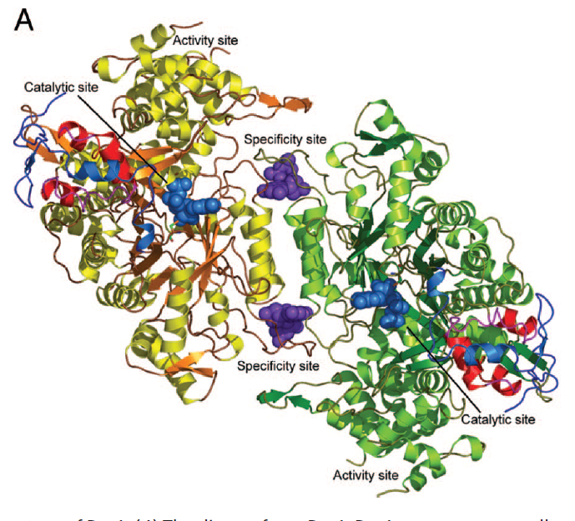
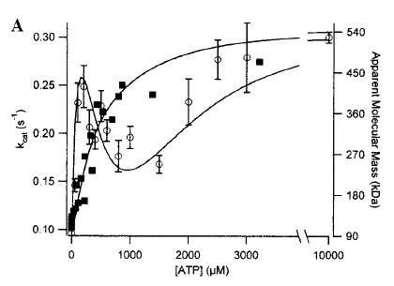
ATP-induced R1 Hexamerization
R = R1
X = ATP
2+5+9+13 = 28 parameters => 2²⁸=2.5x10⁸ spur graph models via K_{j}=∞ hypotheses
28 models with 1 parameter, 428 models with 2, 3278 models with 3, 20475 with 4
Data of Kashlan et al. Biochemistry 2002 41:462
Yeast R1 structure. Dealwis Lab, PNAS 102, 4022-4027, 2006

Slide 18
Fits to R1 Mass Data
Data from Kashlan et al. Biochemistry 2002 41:462
2088 Models with SSE < 2 min (SSE)
28 of top 30 did not include an h-site term; 28/30 ≠ 503/2081 with p < 10⁻¹⁶. This suggests no h-site.
Top 13 all include R6X8 or R6X9, save one, single edge model R6X7 This suggests less than 3 a-sites are occupied in hexamer. Radivoyevitch, T. , Biology Direct 4, 50 (2009).

Slide 19
~1/2 a-sites not occupied by ATP?
nucleus
flux
activation
inhibition
ADP
dATP
dCK
dA
DNA polymerase
GDP
dGTP
DNA
dCK
dG
CDP
dCTP
ATP
or
dATP
RNR
dCK
a
dC
mitochondria
R1
R1
UDP
dTTP
DCTD
a
a
cytosol
cytosol
R1
R1
5NT
R1
R1
a
TS
dUDP
dUMP
TK1
dA
dAMP
dATP
a
dT
dGK
dU
dG
dGMP
dGTP
a
dUTP
dUTPase
dN
dC
TK2
dCMP
dCTP
dT
dTMP
dTTP
dN
NT2
[ATP]=~1000[dATP]
So system prefers to have 3 a-sites empty and ready for dATP
Inhibition versus activation is partly due to differences in pockets

Slide 20
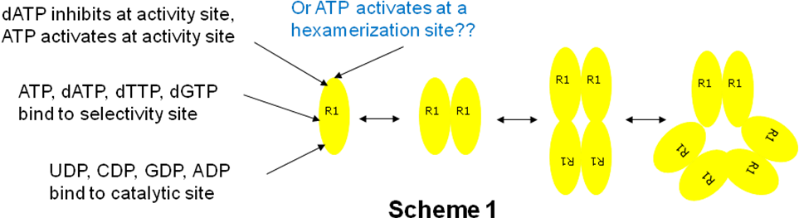
Fits to RNR Activity Data

Slide 21
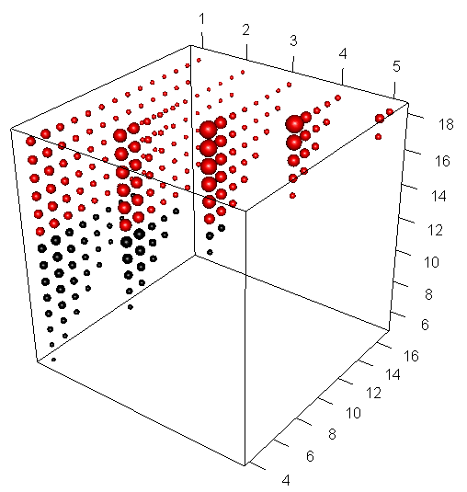
Distribution of Model Space SSEs
Models with occupied h-sites are in red, those without are in black. Sizes of spheres are proportional to 1/SSE.

Slide 22
Microfluidics
Figure 8. T. Thorsen et al. (S. R. Quake Lab) Science 2002
Figure 9. J. Melin and S. R. Quake Annu. Rev. Biophys. Biomol. Struct. 2007. 36:213–31
Figure 9 shows how a peristaltic pump is implemented by three valves that cycle through the control codes 101, 100, 110, 010, 011, 001, where 0 and 1 represent open and closed valves; note that the 0 in this sequence is forced to the right as the sequence progresses.

Slide 23
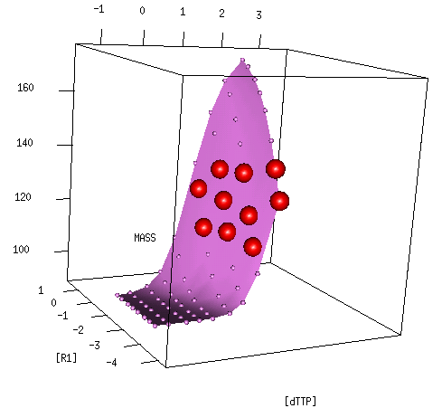
Adaptive Experimental Designs
Find best next 10 measurement conditions given models of data collected.
Need automated analyses in feedback loop of automatic controls of microfluidic chips

Slide 24
Why Systems Biology
Model components: (Deterministic = signal) + (Stochastic = noise)
Statistics
Engineering
Emphasis is on the stochastic component of the model.
Is there something in the black box or are the input wires disconnected from the output wires such that only thermal noise is being measured?
Do we have enough data?
Emphasis is on the deterministic component of the model
We already know what is in the box, since we built it. The goal is to understand it well enough to be able to control it.
Predict the best multi-agent drug dose time course schedules
Increasing amounts of data/knowledge

Slide 25
Indirect Approach pro-B Cell Childhood ALL
T: TEL-AML1 with HR
t : TEL-AML1 with CCR
t : other outcome
B: BCR-ABL with CCR
b: BCR-ABL with HR
b: censored, missing, or other outcome
Ross et al: Blood 2003, 102:2951-2959
Yeoh et al: Cancer Cell 2002, 1:133-143
Radivoyevitch et al., BMC Cancer 6, 104 (2006)

Slide 26
Folate Cycle (dTTP Supply)
Morrison PF, Allegra CJ: Folate cycle kinetics in human breast cancer cells. JBiolChem 1989, 264:10552-10566.
NADP⁺
NADPH
DHFR
Hcys
Met
10
MTR
4
THF
7
FAICAR
DHF
5
6
HCOOH
12
FDS
ATP
ATIC
11
2R
2
ATIC
Ser
FTS
CHODHF
HCHO
ADP
SHMT
Gly
AICAR
13
CH₃THF
FGAR
1R
1
GART
NADP⁺
NADPH
GAR
NADP⁺
NADPH
MTHFD
CHOTHF
3
MTHFR
8
9
CH₂THF
TS
dUMP
dTMP

Slide 27
Conclusions
For systems biology to succeed:
  move biological research toward systems which are best understood
  specialize modelers to become experts in biological literatures (e.g. dNTP Supply)
Systems biology is not a service

Slide 28
Acknowledgements
Case Comprehensive Cancer Center
NIH (K25 CA104791)
Charles Kunos (CWRU)
John Pink (CWRU)
James Jacobberger (CWRU)
Anders Hofer (Umea)
Yun Yen (COH)
And thank you for listening!

Slide 29
Comments on Methods
Fast Total Concentration Constraint (TCC; i.e. g=0) solvers are critical to model estimation/selection. TCC ODEs (#ODEs = #reactants) solve TCCs faster than k_{on} =1 and k_{off} = K_{d} systems (#ODEs = #species = high # in combinatorially complex situations)
Semi-exhaustive approach = fit all models with same number of parameters as parallel batch, then fit next batch only if current shows AIC improvement over previous batch.

Slide 30
Conjecture
Greater X/R ratios dominate at high Ligand concentrations. In this limit the system wants to partition as much ATP into a bound form as possible

Slide 31
ccems Sample Code
library(ccems) # Ribonucleotide Reductase Example
topology <- list(
heads=c("R1X0","R2X2","R4X4","R6X6"),
sites=list( # s-sites are already filled only in (j>1)-mers
a=list( #a-site thread
m=c("R1X1"), # monomer 1
d=c("R2X3","R2X4"), # dimer 2
t=c("R4X5","R4X6","R4X7","R4X8"), # tetramer 3
h=c("R6X7","R6X8","R6X9","R6X10", "R6X11", "R6X12") # hexamer 4
), # tails of a-site threads are heads of h-site threads
h=list( # h-site
m=c("R1X2"), # monomer 5
d=c("R2X5", "R2X6"), # dimer 6
t=c("R4X9", "R4X10","R4X11", "R4X12"), # tetramer 7
h=c("R6X13", "R6X14", "R6X15","R6X16", "R6X17", "R6X18")# hexamer 8
)
)
)
g=mkg(topology,TCC=TRUE)
dd=subset(RNR,(year==2002)&(fg==1)&(X>0),select=c(R,X,m,year))
cpusPerHost=c("localhost" = 4,"compute-0-0"=4,"compute-0-1"=4,"compute-0-2"=4)
top10=ems(dd,g,cpusPerHost=cpusPerHost, maxTotalPs=3, ptype="SOCK",KIC=100)

