Slide 1

Integrated quantitative modeling of radiation induced chronic myeloid leukemia (CML)
Tomas Radivoyevitch
Lynn Hlatky
Julian Landaw and Rainer Sachs
Blood 2012;119(19):4363-71
Center of Cancer Systems Biology

Slide 2
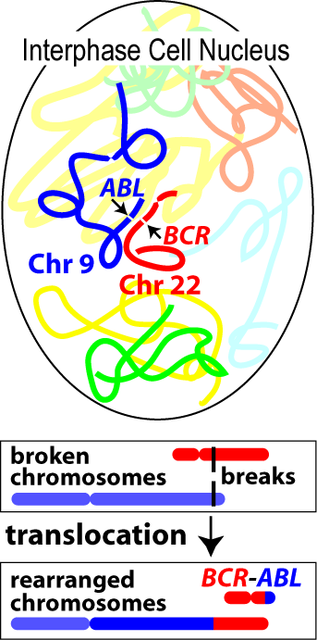
Why Study CML?
Homogeneity: all have BCR-ABL
Prevalence: SEER CML/APL = ~ 8
Understanding: imatinib success
=> BCR-ABL causes CML
Chr 22
Chr 9
22-
Philadelphia Chromosome
9+
SEER = Surveillance, Epidemiology and End Results
APL = Acute Promyelocytic Leukemia (~homogeneous in PML-RARA)

Slide 3
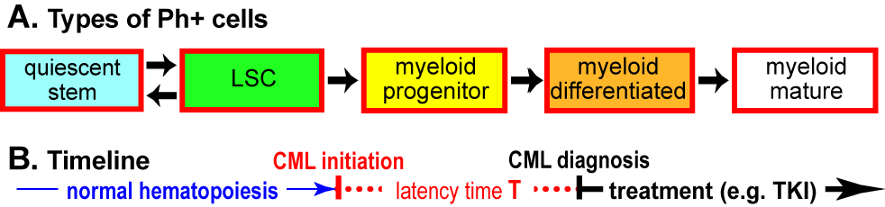
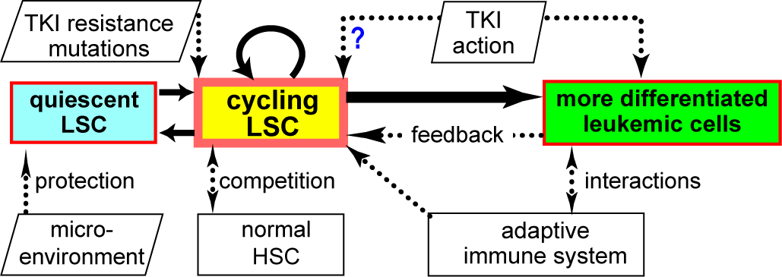
Cell Population Dynamics Models
Stop TKI with 1 left is like ??
Michor
Wodarz
Radiation Biology can get at these
HSC estimates via age and dose responses of CML and translocations
Roeder
Moore
Levy
Dingli

Slide 4

Two CML-ogens: Radiation and Age
$$y=Ae^{k∗age}$$
data from SEER

Slide 5
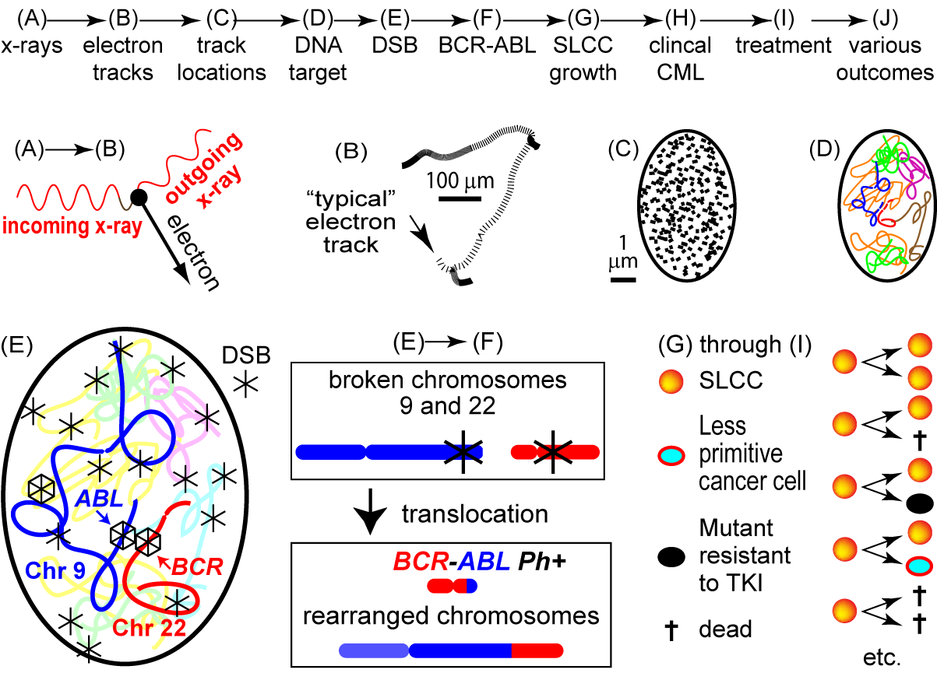
Radiation-induced CML is multi-scale
For a 500 keV incoming photon

Slide 6
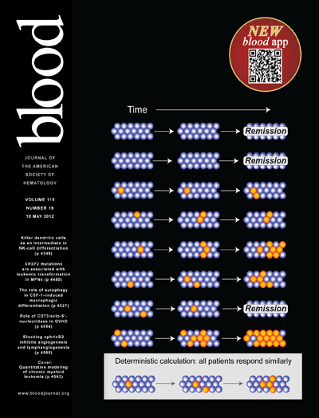
Stochastic versus Deterministic
We were covered
in Blood on
May 10 2012

Slide 7
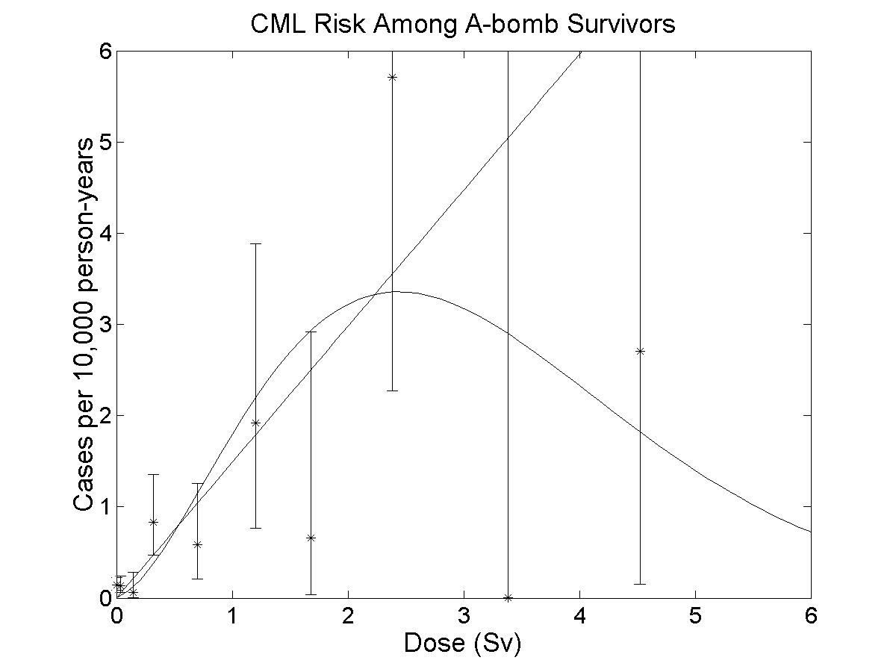
Dose Response
background
Poisson probability of zero lethal hits
# target cells/individual
probability of BCR-ABL given a translocation
expected # of total translocations per cell
D = dose in Sv
P(ba|T) = 2T_{abl}T_{bcr}/Γ² ???
T_{BCR} = 5.8 kb; T_{ABL} = 140 kb; Γ = 3 Gb
N = 4x10⁸ too high
P(ba|T) bigger => N smaller

Slide 8
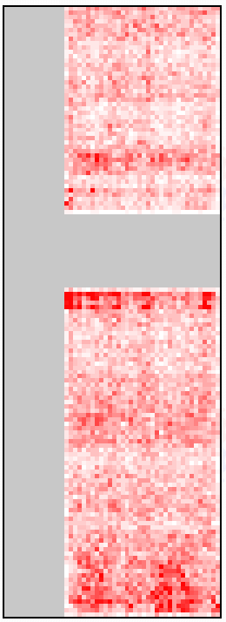
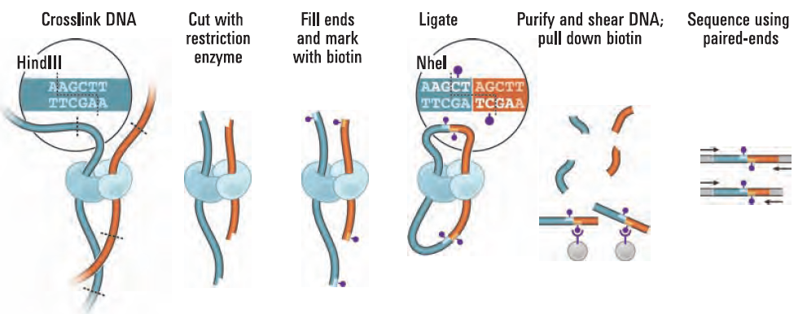
Hi-C Data
http://hic.umassmed.edu/heatmap/heatmap.php
EBV-transformed lymphoblasts
Lieberman-Aiden et al. Science, 9 October 2009: 289-293.
chr9
ABL @133 Mb and BCR @ 23 Mb
chr22
Notes:
Chr 9 = 140 Mb, Chr 22 = 50 Mb

Slide 9
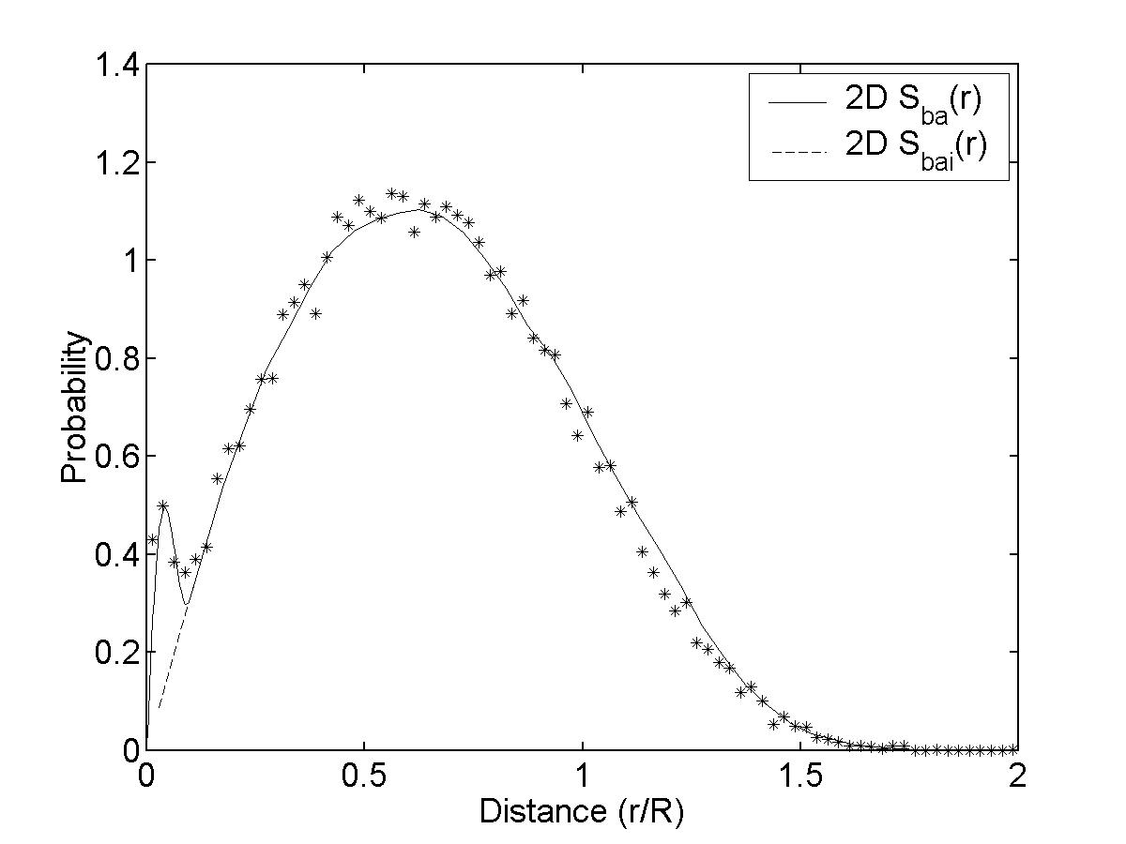
BCR-to-ABL interphase distances by FISH
Kozubek et al. (1999) Chromosoma 108: 426-435

Slide 10
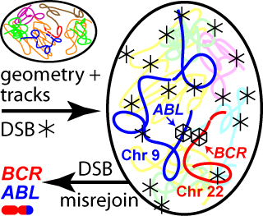
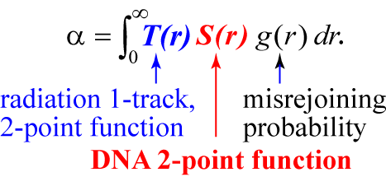

Micro- to kilo-seconds: BCR-ABL formation
estimated number of translocations per cell is αD + βD²
1-track action
2-track action
Loci specific versions give BCR-ABL estimates

Slide 11
Risk and HSC numbers
Higher risk estimate is more biologically plausible
Linear-to-quadratic transition dose α/β increases from ~0.3 Gy to ~8 Gy
=> ~3-fold increases in estimates of risk in the limit of low doses of γ-rays
Proximity ↔ linear dose dependence as observed
estimates of HSC from 400 to ~10⁶
=> target cells may be progenitors that are slightly less primitive than HSC ??

Slide 12
Main Conclusions
HSC estimation is synergistic with radiation-induced CML risk estimation
BCR and ABL loci unusually close favors 1-track action and thus LNT, in contrast to linear-quadratic behavior of other radiogenic leukemias

Slide 13
Bcr-Abl to CML Waiting Times
M/F=1.47
tf-tm=10 yrs
M/F=1.42
tf-tm=6.3y

Slide 14
Age at Exposure Dependence
=> Gender difference in age responses is an amplitude (more than latency) difference

Slide 15
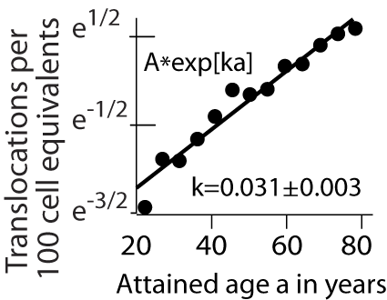

Age dependence of chromosome translocations and CML
If initiation increases with age, fewer stages may be needed to model some cancers
$$y=Ae^{k∗age}$$
Chromosome translocation clone incidence exponential with a comparable k => ~ 1 hit
Data = controls for radiation biodosimetry
Sigurdson AJ et al., 2008, International study of factors affecting human chromosome translocations, Mutation research 652:112-21.
Notes:
Figure out how fast point mutations pile up with age to see if a second hit with a k of 0.07 may explain the difference

Slide 16
Acknowledgements
Co-authors
  Rainer Sachs (UC Berkeley and Tufts Unversity)
  Lynn Hlatky (Tufts University)
  Julian Landaw (UC Berkeley)
Collaborators
  Yogen Saunthararajah (Cleveland Clinic)
  James Jacobberger (Case Western)
Funding
  Tufts ICBP, Epidemiology & Biostatistics (Case)
Thank you!

Slide 17
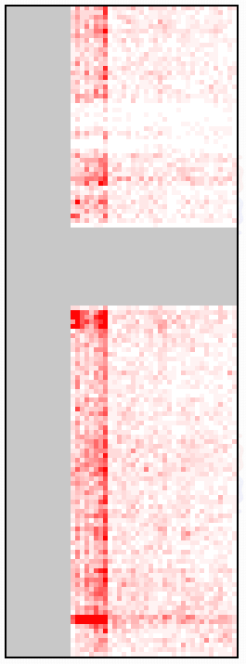
http://hic.umassmed.edu/heatmap/heatmap.php
K562 bcr-abl+ = control
EBV-transformed
lymphoblasts
chr9
Lieberman-Aiden et al. Science, 9 October 2009: 289-293.
ABL @133 Mb and BCR @ 23 Mb
chr22

Slide 19
Dose Response
N is the number of CML target cells in an individual
P(ba|T) is the probability of BCR-ABL given a translocation
w(t)=probability density that CML arrives at t given bcr-abl at t=0
Linear R = 0.0075/Gy. LQE posterior R = 0.0022/Gy

Slide 20
Theory, Risk and HSC numbers
  P(ba|D) = probability of a BCR-ABL translocation per G₀/G₁ cell given a dose D
  t_{D}(r)dr = expected energy at r given an ionization event at the origin
  = intra-track component + inter-track component
  S_{ba}(r) = the BCR-to-ABL distance probability density
  g(r) = probability that two DSBs misrejoin if they are created r units apart
  For p₀ and r₀ can be estimated from α_{x}, α_{γ} and β for all tlcns
  Y = 0.004 DSBs per Mb per Gy; ρ = mass density; T_{BCR} = 5.8 kbp; T_{ABL} = 140 kbp
⇒
Higher risk estimate is more biologically plausible

Slide 21
Nagasaki HSC Reserve Loss?
6 Nagasaki CML vs 53 in Hiroshima
Hiroshima PY=1558995
Nagasaki PY= 690084 (2.26 lower)
53/2.26 = ~23 cases expected in Nagasaki => HSC reserve permanently depleted to 25%?
Human T-cell leukemia virus (HTLV): 22 adult T-cell leukemias (ATLs) in Nagasaki compared to 1 in Hiroshima (2.26 more PY => expect ~50)
Lymphocyte demand drains HSCs
Dead-band HSC control =>prophylaxis
background was lower than US
US male and female CML incidence rates
Notes:
This slide can get yanked out if there isn’t enough time

Slide 22
Dead-Band Control of HSC levels
Transplant doses of 10, 100, and 1000 CRU => CRU levels 1-20% or 15-60% normal Blood (1996) 88: 2852-2858
Broad variation in human HSC levels Stem Cells (1995) 13: 512-516
Low levels of HSCs in BMT patients Blood (1998) 91: 1959-1965

